Slide 1
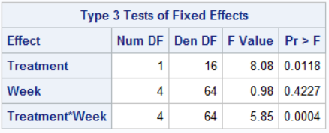
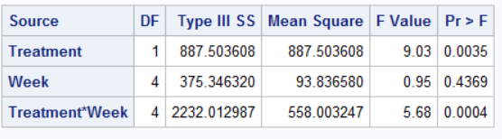
Discussion 1
GLM ------ Mixed
The values on the tables are rather similar, that is nothing that is significant in one is not significant in the other and vice versa.
The difference comes from the fact that the mixed takes the number of repeated measures into account for the degrees of freedom (though I’m not sure why they equal what they do here since there are 5 repeated measures and 18 subjects?)

Slide 2
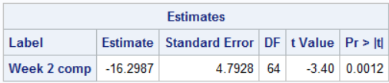
Discussion 2
This compares average correct week 2 for treatment with week 2 for control (treatment – control)
It indicates that the treatment had an average of 16.3% fewer correct than the control group

Slide 3
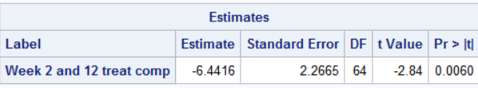
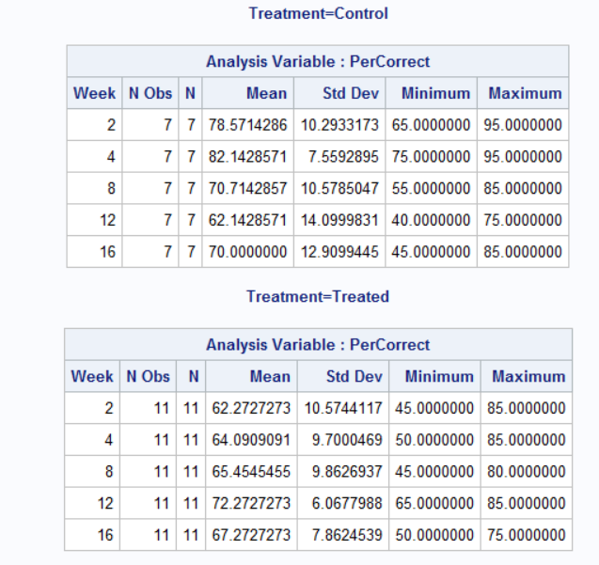
Discussion 3
For this one I tried many combinations but kept getting ‘non-est’. The closest I got was doing this:
But this seems to be giving me (62 – 78) – (72 – 62)
I don’t understand why it won’t work for the interaction and
I can’t figure out how to isolate just the treatment group without
comparing to control

Slide 4
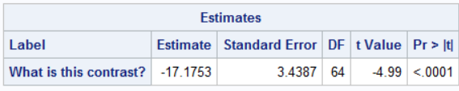
Discussion 4
This contrast is comparing the average of weeks 2 and 4 for the control and the treatment (2/4 avg control – 2/4 avg treatment)

